Slide 1
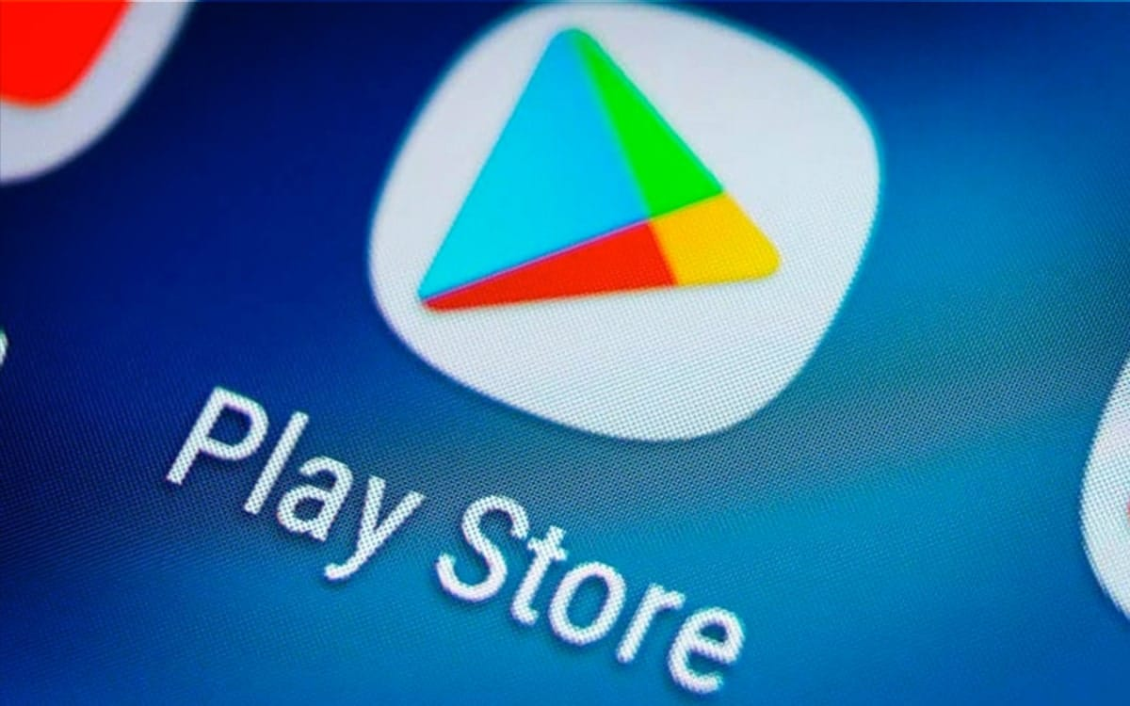
Capstone Project 1
Play Store App Review Analysis
By- Saugata Deb Harshad Savle Prasoon Kumar

Slide 2
Introduction
Android is the most popular operating system in the world, with over 3 billion active users spanning over 190 countries.
Google Play was launched on March 6, 2012, bringing together Android Market marking a shift in Google's digital distribution strategy .
Lots of designers and developers work on it to make an app successful on the Play Store.
There are more than 5 million apps found on Google Play Store.
.

Slide 3
Contents
Introduction
Objective
Problem Statement
Description of data
Cleaning the data
Exploratory analysis and visualizations
Sentiment analysis
conclusion

Slide 4
Objective
The main objective of this Project is to gather and understand client demands and help them compete with competitors and also developers to make their Apps better and popular on the Play Store.

Slide 5
Problem Statement
Top Categories in Playstore?
Top Genres in the Playstore?
Top Content Rating per installation?
What is the percentage of free and paid Apps in the Play Store?
What is the effect of the last update on rating?
How does the last update have an effect on the trend of rating?
Effect on rating when the application was of type free and paid?
Relationship between reviews and rating?
relationship between Rating and Average Reviews
Average Rating of each App category

Slide 6
Problem Statement
11. Average Rating for each genre
12. What is the distribution of sentiment subjectivity?
13. How sentiment polarity varies with Free and Paid Apps?
14. Different percentages of review sentiments based on two Datasets provided?
15. Different percentages of sentiment analysis on top 5 Reviewed App Categories?
16. Sentiment Analysis on each App Category
17. Sentiment Analysis on the basis of Genres

Slide 7
Description of Dataset
There are two dataset: Play Store Data & User Data
Play Store Data:-
App - Name of the Application
Category - Category of the Application
Rating - Rating given to the Application
Reviews - No of reviews given to the Application
Size - Size of the Application
Installs - No of downloads of the Application
Type - Free or Paid
Price - Price of the Application if it is paid

Slide 8
Description of Dataset
Content Rating-It is Age appropriate or Not
Genres - Type of Genre the Application belongs to
Last Updated - When the last time the Application is Updated
Current Ver - Current version of the Application
Android Version- Minimum Android version required to run the Application

Slide 9
Description of Dataset
2. User Review Data:
App – An app name
Translated_Review:- Reviews being given by consumer
Sentiment – Sentiment given to an app by users ( i.e. Positive, Neutral, Negative)
Sentiment Polarity – The polarity of sentiment measures how negative or positive the context is. In the data we have, the polarity ranges from +1(Positive) to -1(Negative).
Sentiment Subjectivity - The subjectivity of a sentiment is how likely that sentiment is to be based on data or factual information, versus personal opinions or public notions.

Slide 10
Data Cleaning
Data cleaning not just means removing the incorrect data or erroneous data. Many times we get the data which has all kinds of values some of them will cause problems during the analysis of the data and make our predictions incorrect. So we have to make sure our data has no erroneous values.
Data Cleaning Step:
Removing unwanted Values : Deleting of duplicate/incorrect or irrelevant values
Handling Missing Values: Handling missing values in our Dataset
Handling Structural Errors: Fixing mislabelled categories or classes, Types, Strange name conventions
Filtering Unwanted Outliers: Removing incorrect or unwanted outliers
Replacing missing values with mean,median or mode: Replacing missing values with median is the most popular method of replacing missing values

Slide 11
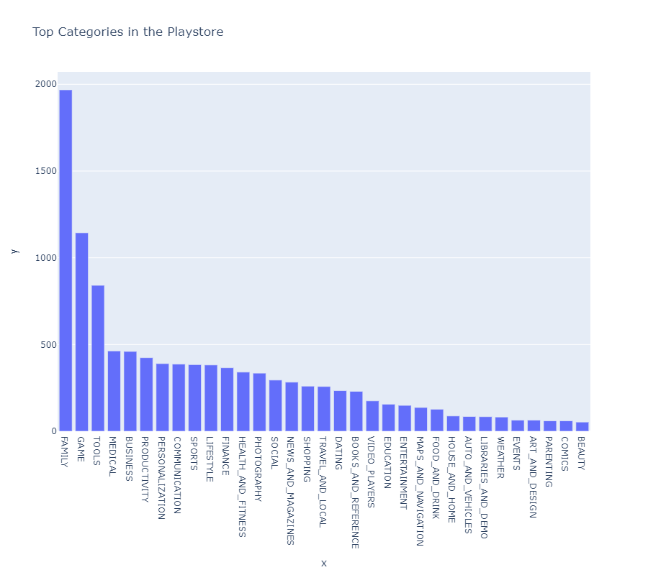
Data Analysis & Visualization
Top Categories in Playstore
From above graph we can conclude that there is 1939 applications which falls under FAMILY category.
Also top 5 categories of Application in the playstore are FAMILY,GAME,TOOLS,,BUSINESS,MEDICAL.
Also there is only 53 applications which falls under BEAUTY category.
We can also conclude that there is significant difference between the top two categories FAMILY 1939 Apps and GAME 1121 Apps.
This shows that there are more application
developers who develops Apps under FAMILY. Category.

Slide 12
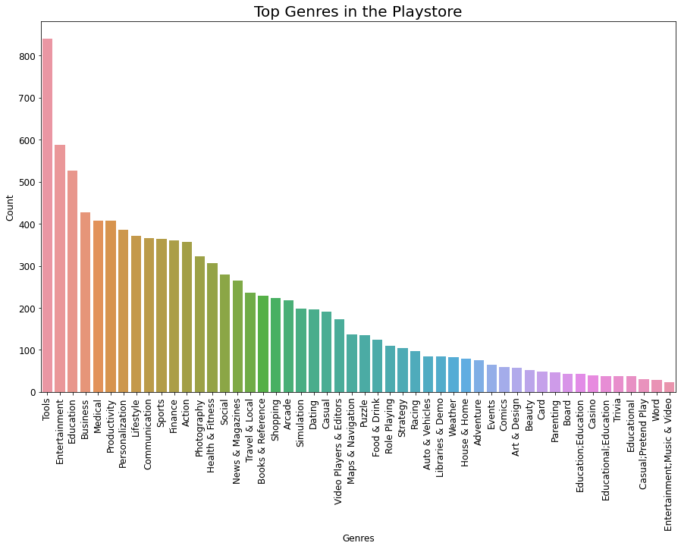
Data Analysis & Visualization(Cont..)
Top Genres in the Playstore
From above bar plot in plotly we can conclude that maximum application which have been developed falls under App Genre Tools 840.
Also from above we can observe from above plot that least applications were developed under App Genre Entertainment,Music & Video 23.
Also top 5 Genres are Tools,Entertainment,Education,business and Medical which are 840,587,427,407,460 in Top 5 Genre name order.

Slide 13
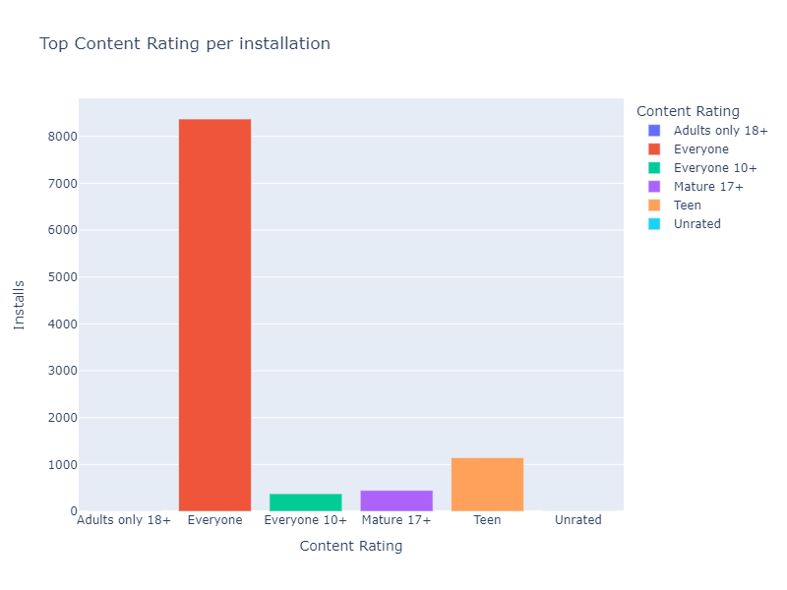
Data Analysis & Visualization(Cont..)
Top Content Rating of each Category of App per installation
From above graph by plotly we can conclude that App Having 'Content Rating' - Everyone is having maximum number installation of 100.228B
Also we can conclude that there are 4.29B installation for application
having Content Rating of Everyone 10+.
We can also conclude that there are no such noticeable
installation for Application having Content Rating
of Adults only 18+ and Unrated.

Slide 14
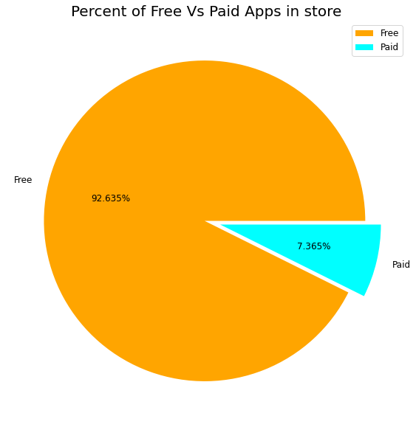
Data Analysis & Visualization(Cont..)
What is the percentage of free and paid Apps in the Play Store?
From the above chart we can conclude that most of the apps available
on the playstore are free which are enjoyed by most of the users.
Free Apps= 92.635%
Paid Apps= 7.365%

Slide 15
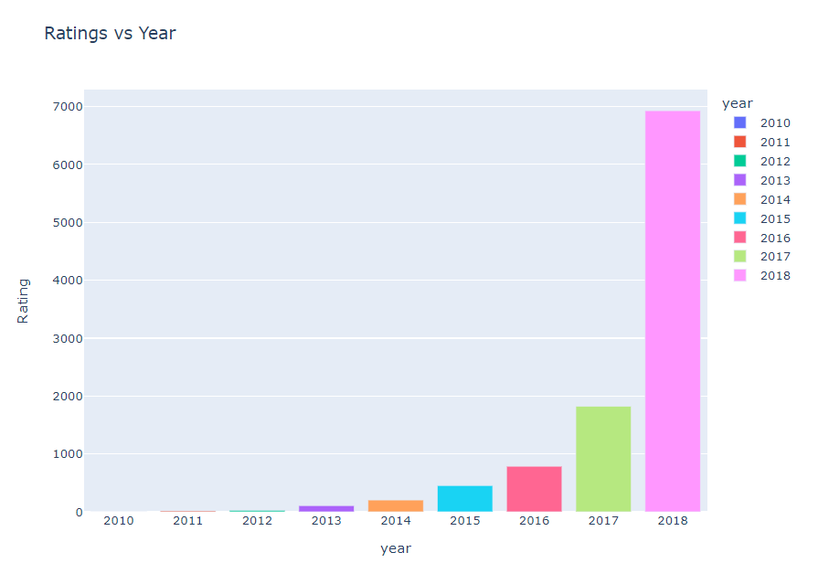
Data Analysis & Visualization(Cont..)
Effect of the last update on rating
From this graph from plotly we can conclude that there
is more number ratings given the application which are
updated recently in 2018 no. of rating is 6929 than those
application which were updated in 2017 no .of rating 1823.
This shows with the latest update user reviews response
increases for both less or more ratings.

Slide 16
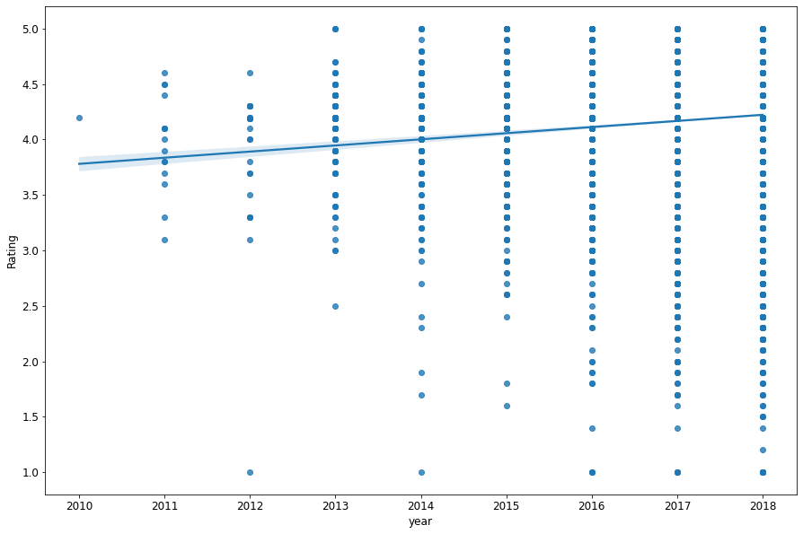
Data Analysis & Visualization(Cont..)
Effect of the last update on the trends of rating
From this graph from matplotlib and seaborn we can
conclude that rating is increasing in a proportionate
manner with the last updated time. So from this we
can be sure that with the latest update the reviewers
are giving better rating.

Slide 17
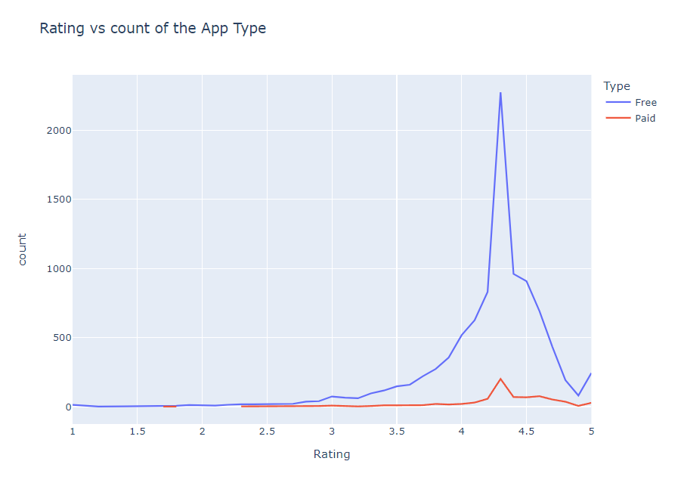
Data Analysis & Visualization(Cont..)
Effect on rating when the application was of type free and 'paid':
From the above graph using plotly we can conclude that the Free Apps has got more rating in terms of number of rating. From this we can also see that the users of free App are way higher than those who uses paid App.
But we try watch very clearly the highest rating
for both the Free and Paid Apps are 5. But if we
go on finding the average of both the type of
App we can see that the Average rating of the
Free Apps will be less as compared to that of
the Paid Apps . Again for the same that no. of
users in Free Apps are way too high . For Example
Free App for Rating 4.3 has a number count of 2275
as compared to only 201 count of rating for paid Apps
with same Rating 4.3.

Slide 18
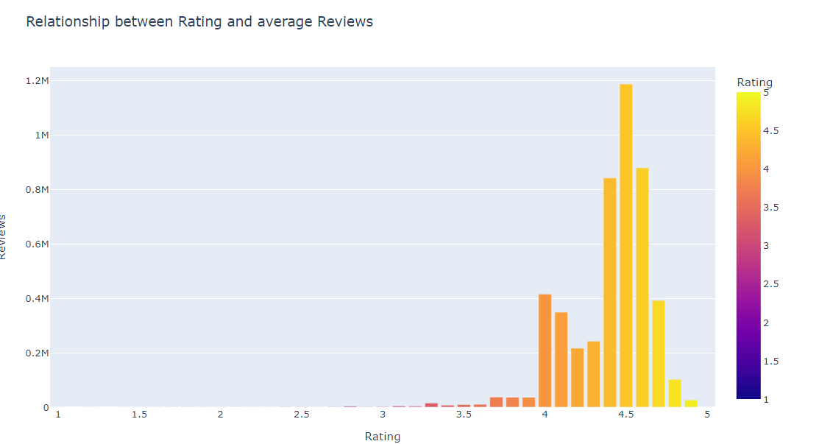
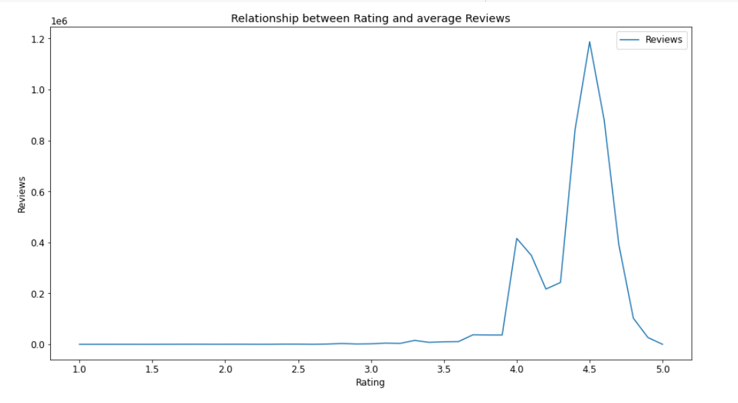
Data Analysis & Visualization(Cont..)
Relationship between Rating and Average Reviews:
From the above graph we can conclude that as the rating
increases the average reviews for each ratings also increases.
Also we can observe some deviation after 4.5 rating as we
can see 4.5 rating has maximum no.of reviews of 1.1M and
reviews increases in quite proportionate manner with the
increase of rating but after 4.5 rating reviews eventually
decreases and we can see only around 26586 reviews.

Slide 19
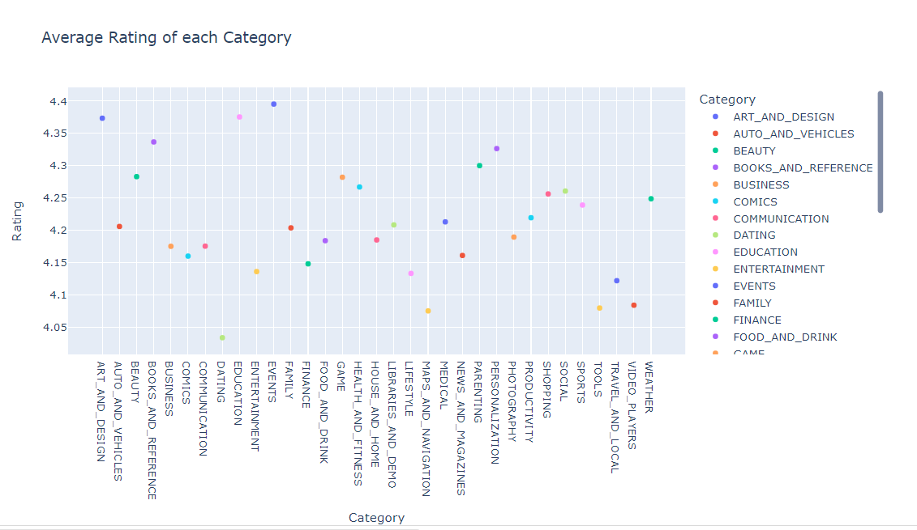
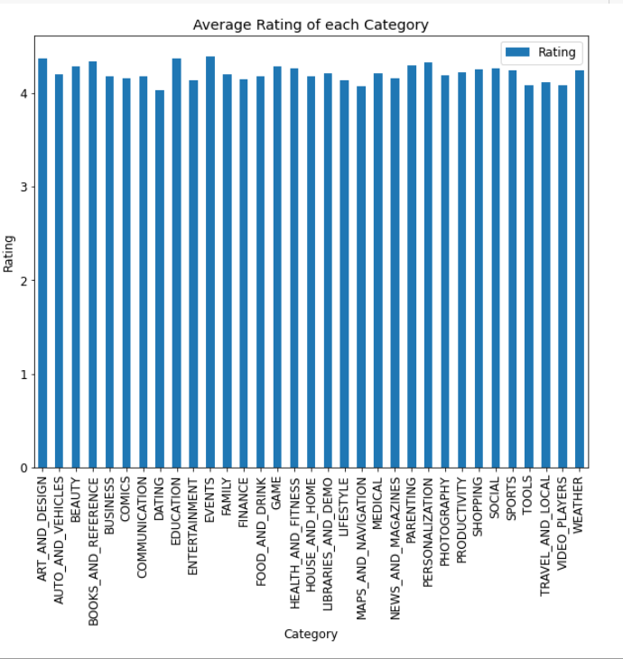
Data Analysis & Visualization(Cont..)
Average Rating of each category:
From above plot from plotly we can conclude that 'Event'
category has got highest Average Rating of 4.39.
Also we can see that 'Dating' Category has got Lowest
Average Rating of '4.033673'

Slide 20
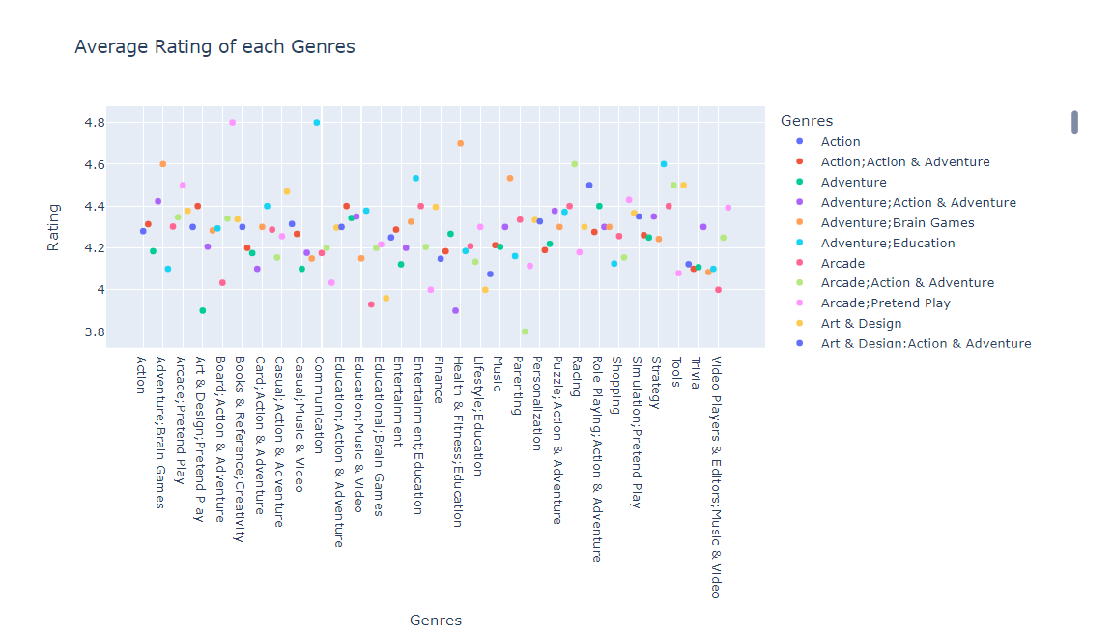
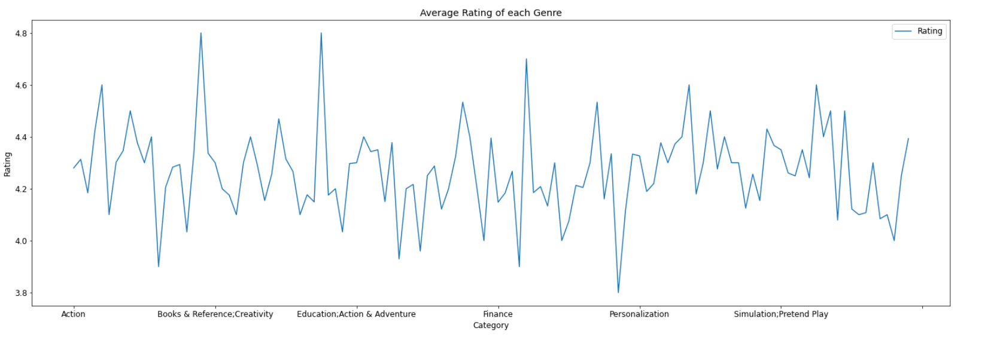
Data Analysis & Visualization(Cont..)
Average Rating of each genre:
From the scatter plot from plotly we can conclude that both
the Genre-'Board;Pretend Play' and 'Comics;Creativity' is
having the highest Average Rating of 4.8 and Genre-'
Parenting;Brain and Games' has got lowest
Average Rating.

Slide 21
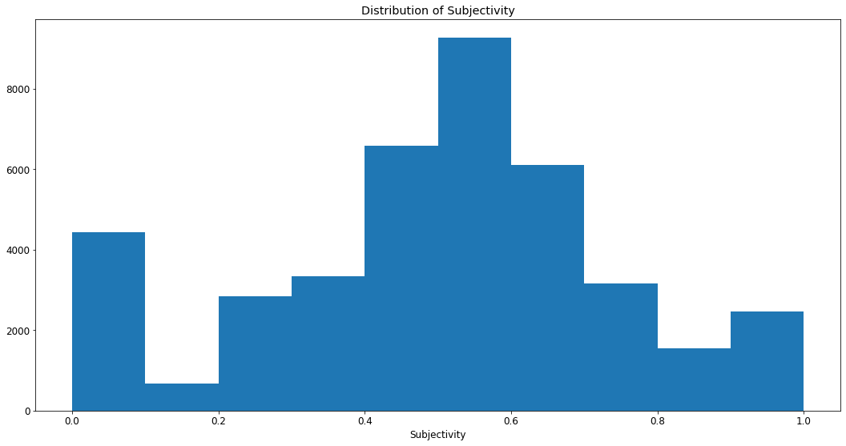
Sentiment Analysis
The distribution of sentiments subjectivity:
It can be seen that maximum number of sentiment subjectivity
lies between 0.4 to 0.7. From this we can
conclude that maximum number of users
give reviews to the applications,
according to their experience.

Slide 22
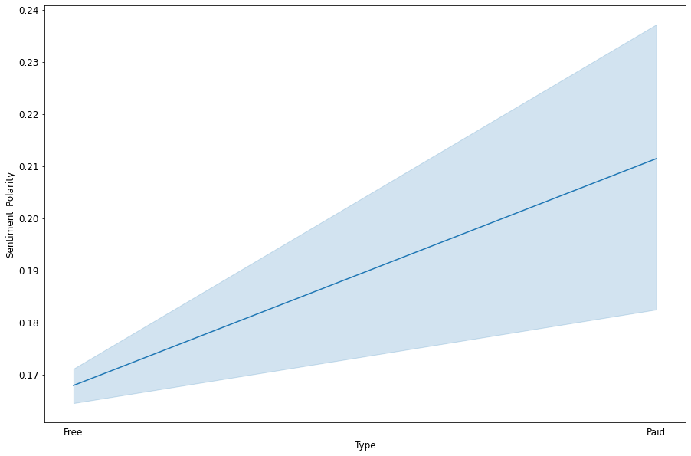
Sentiment Analysis(Cont..)
How sentiment polarity varies with Free and Paid Apps?
From the above line plot we can conclude that with increase in sentiment polarity ,the sentiment polarity for the paid app is higher than the sentiment polarity
for free app. This means people has more sentiment
towards paid App than free App.

Slide 23
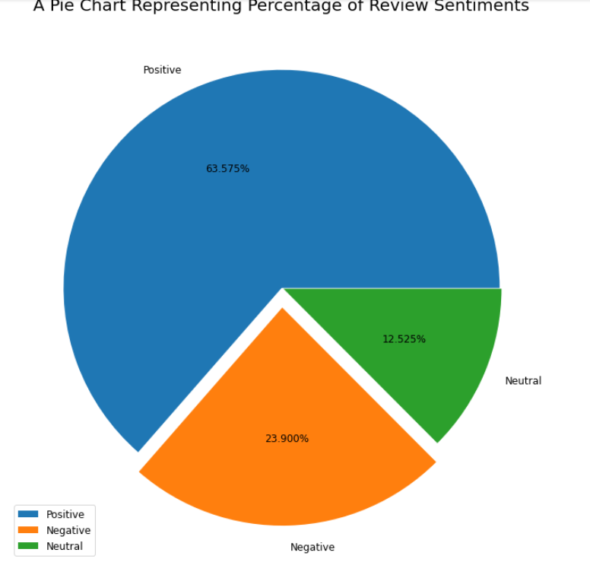
Sentiment Analysis(Cont..)
Different percentages of review sentiments based on two Datasets provided?
From this pie Chart we can conclude that most of the
sentiment reviews given by the user are positives with
63.625%. But also there is a negative sentiment percentage
of 24.976% which is higher than the one with the neutral
sentiments with 11.399%. This means app developers needs
to convert more negative sentiments to neutral or positive
sentiments with their Hard work

Slide 24
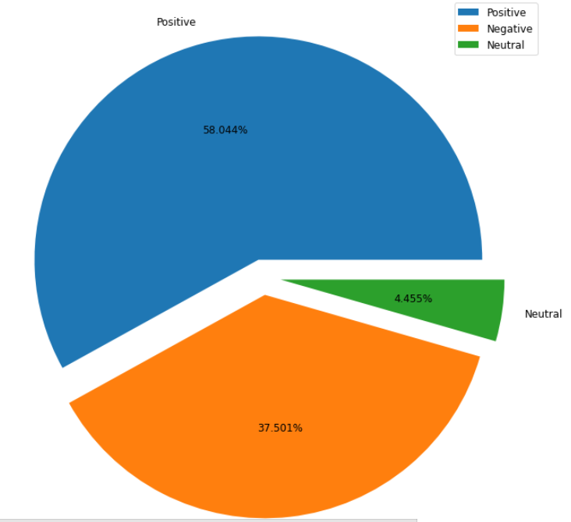
Sentiment Analysis(Cont..)
Different percentages of sentiment analysis on top 5 Reviewed Categories
From the above figure we conclude that 'HEALTH_AND_FITNESS' Category
has got highest positive percentage of 77.119% and negative sentiment
percentage of 11.494% and neutral percentage of 11.388%
Also we found that top Category GAME has less positive
sentiment percentage of 50.04% than it's competitor.
Most negative sentiments from the top translated app
category has been received by GAME CATEGORY.THIS shows
that even if GAME app has the highest translated
reviews but in positive sentiment percentage it is lower than
it's counterparts.
Highest percentages of neutral sentiments has been claimed
by SPORTS category from the list top 5 App category.

Slide 25
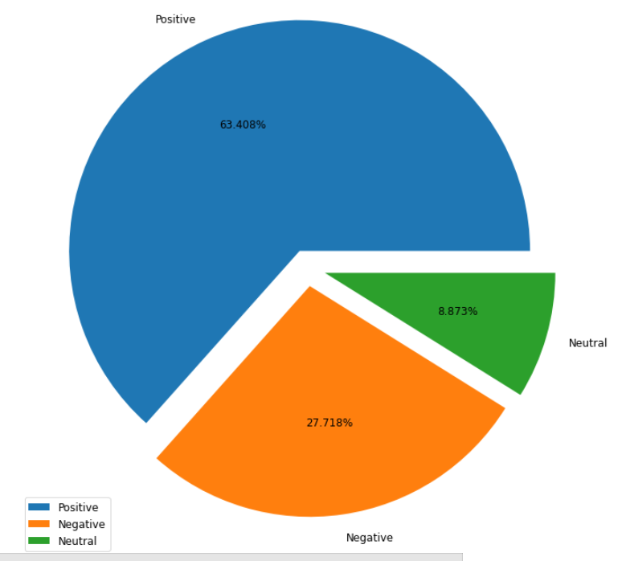
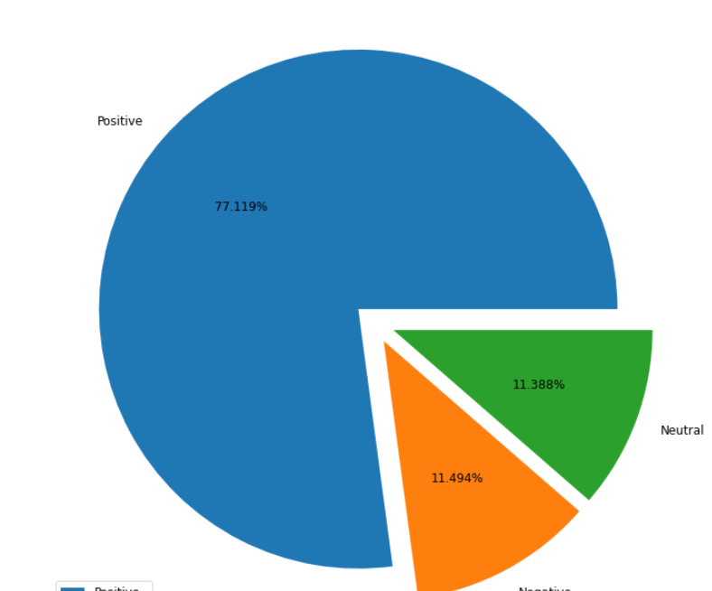
Sentiment Analysis(Cont..)
Different percentages of sentiment analysis on top 5 Reviewed Categories

Slide 26
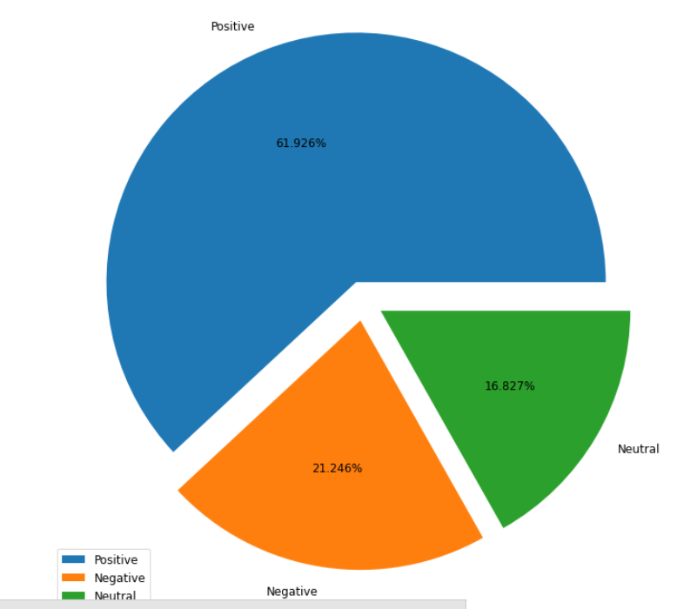
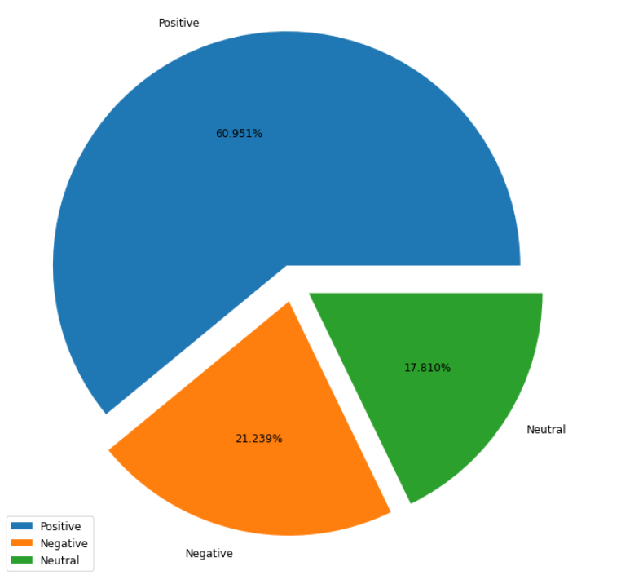
Sentiment Analysis(Cont..)
Different percentages of sentiment analysis on top 5 Reviewed Categories

Slide 27
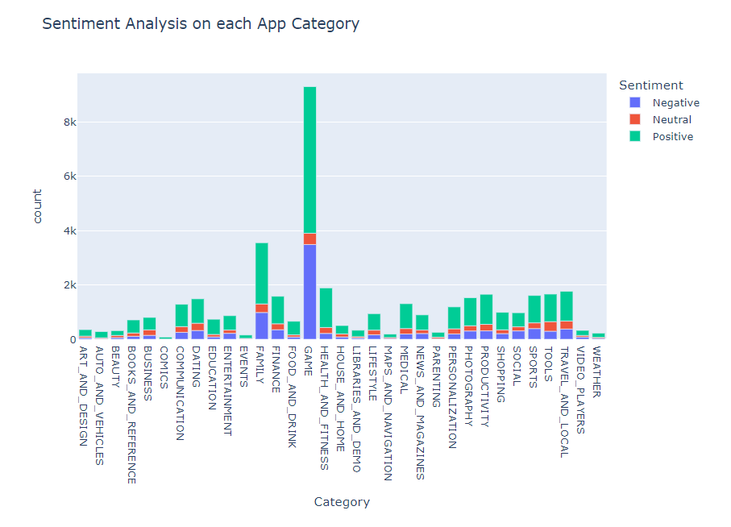
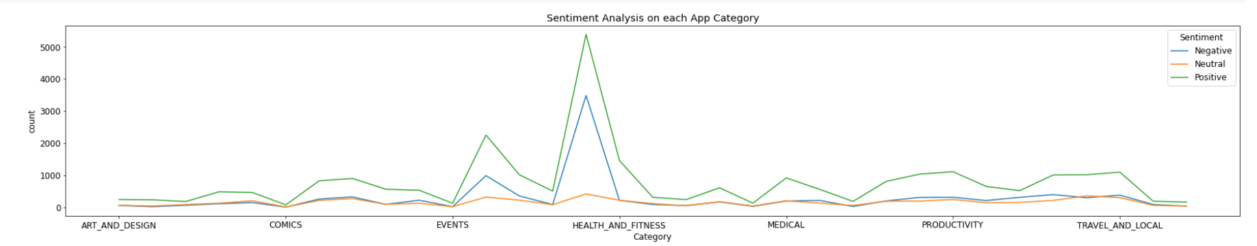
Sentiment Analysis(Cont..)
Sentiment Analysis on each App Category
From Above bar plot we can conclude that GAME Category has got most positive sentiment in terms of count but if we take percentage of positive vs negative sentiment we will found that HEALTH_AND_FITNESS has got the highest positive sentiment percentage.
Again if we count on the basis of the count of positive sentiment we can see that Category comic has got least number of positive sentiment and no negative sentiment as such.

Slide 28
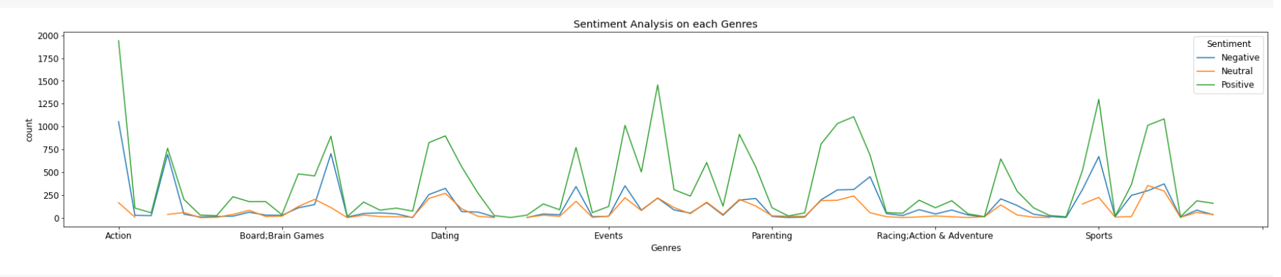
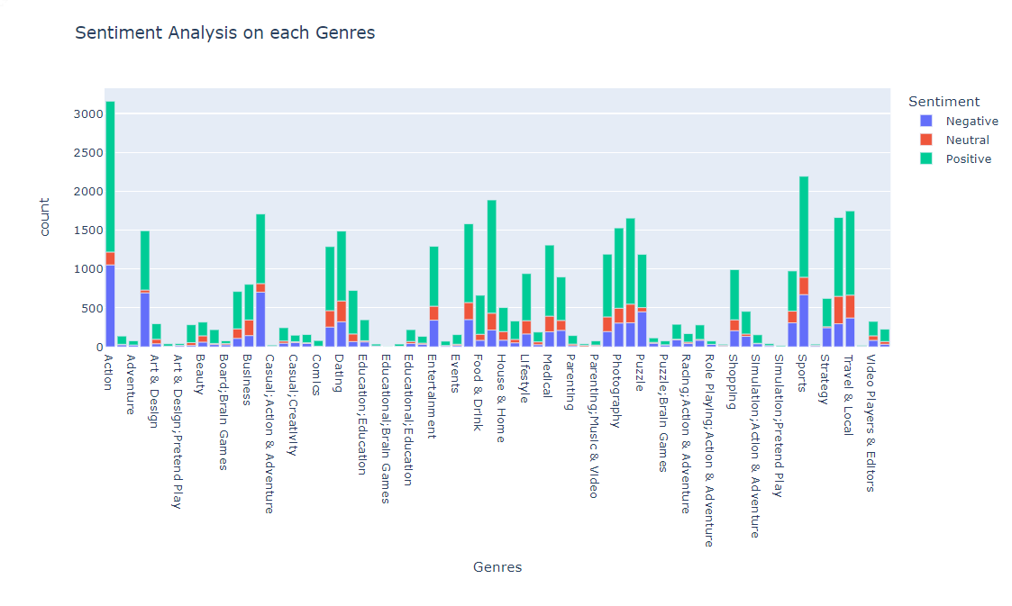
Sentiment Analysis(Cont..)
sentiment Analysis on the basis of Genres
From Above bar plot we can conclude that Action Genre has got most number positive and negative sentiments.
We can see that Simulation;Pretend Play has got least number of positive sentiments
Also we can notice that 'Education;Brain and Games' has got no Sentiment at all.

Slide 29
Conclusion:
So here we come at the end of our project which is play store App Review Analysis.What we have done just take a short recap. First we have done the removal of null value from rows and columns and the same goes with the removal of duplicates from the datasets. Then we did the formatting for each of the required columns in each dataset.
After analyzing the data we conclude that App with the category Family and the genre tools are in large numbers. Also we can conclude that the number App Rating is directly proportional with the recent update. From this we can see that with all the major updates apps will get more ratings.
We can also conclude that most of the apps which are used by the users have a content rating of ‘Everyone’.
In percentage of Free and Paid App Available in the Play Store we can assume that most apps being used by the users are Free. This shows very few users purchase Apps on playstore.
In rating vs count of App Type we conclude that rating is not get affected even if the app is paid or not but if we go on for finding the average rating we will find that free app will have less average rating compared to paid because of significantly high counts of free Apps as compared to Paid App available in App Store.

Slide 30
Conclusion:
After moving forward when we performed analysis on sentiment subjectivity we found that most of the opinion on sentiment subjectivity lies high in the range 0.4 to 0.7.
When we analyzed sentiment polarity for paid and free Apps we noticed that sentiment polarity for free apps is way less than paid Apps.
In pie presenting the percentages of review sentiment we found that most of the sentiment are positive and neutral review is the lowest. Also in case finding the percentage of sentiments for top 5 Apps we found among top 5 App Category Health and Fitness has received the highest positive sentiments while Game app category has received the highest negative sentiments and Sports App Category has received the highest neutral sentiments.
Important Points to be noted:
All active apps on play store has an an Average Rating of 4.32.
Also we can see that after merging both of the dataset the maximum Average Rating is 4.9.
Also the average sentiment Polarity is 0.16 and average sentiment_subjectivity is 0.49
Also we have noticed that the average size of the Application available on playstore is 21933.38 KB
lastly, all of the calculations and graphs in this project have accuracy in the range of 75% to 80%.

